Slide 1

Employee Data Analysis using Excel
STUDENT NAME: K.PRIYA DHARSHINI
REGISTER NO: 2213371036229
NM ID: 76D00EF766DEEDE88AD4FB421FBED326
DEPARTMENT: BACHELOR OF COMMERCE
COLLEGE: QUAID - E - MILLETH GOVERNMENT
COLLEGE FOR WOMEN(AUTONOMOUS)

Slide 2
PROJECT TITLE
Employee Performance
Analysis using Excel

Slide 3
AGENDA
1. Problem Statement
2. Project Overview
3. End Users
4. Our Solution and Proposition
5. Dataset Description
6. Modelling Approach
7. Results and Discussion
8. Conclusion

Slide 4

PROBLEM STATEMENT
1.Improve employee engagement : Regular feedback and
coaching can boost employee motivation and engagement.
2.Enhance leadership development: Analyzing
performance helps identify future leaders and develop their skills.

Slide 5
PROJECT OVERVIEW
This project analyzes employee performance by examining factors like gender, performance scores, ratings, and achievements. The goal is to identify trends and patterns among different employee categories, such as high, medium, and low
performers. This analysis will help in understanding the factors that contribute to varying levels of performance.

Slide 6
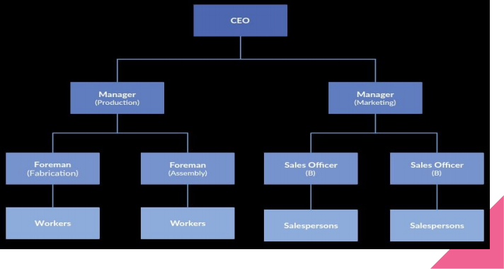
WHO ARE THE END USERS?

Slide 7
OUR SOLUTION AND ITS VALUE
PROPOSITION
Our solution uses Excel's conditional formatting to easily identify and highlight missing values, with filters to remove incomplete data for cleaner analysis. We apply formulas to calculate each employee's performance level and use pivot tables to summarize the findings. Finally, we create graphs for clear data visualization, enabling better decision-making and insights into employee performance trends.

Slide 8
Dataset Description
Employee Information: Includes fields like EmpID, FirstName, LastName, and ADEmail.
Employment Details: Covers the StartDate, ExitDate, Title, Supervisor, BusinessUnit, EmployeeStatus, EmployeeType, and PayZone.
Demographics: Includes DOB, State, GenderCode, RaceDesc, MaritalDesc, and LocationCode.
Performance: Contains Performance Score, Current Employee Rating, TerminationType, TerminationDescription, and DepartmentType.

Slide 9
THE "WOW" IN OUR SOLUTION
The "WOW" in our solution is the use of a simple formula to calculate employee performance levels:
Performance Level = Performance Score + Current Employee Rating
This formula combines both qualitative and quantitative measures, making it easy to assess and visualize overall employee performance. Our solution goes beyond mere metrics. It combines advanced analytics with qualitative feedback to provide a holistic view of employee performance, ensuring that every data point is contextualized by human insights.

Slide 10
MODELLING
● Data Collection: Retrieved the employee dataset from Kaggle.
● Data Cleaning: Used Excel functions and conditional formatting to identify and handle missing values.
● Data Preprocessing: Converted qualitative data into numerical form and calculated the Performance Level using a custom formula.
● Filtering: Removed records with missing values to ensure clean data for analysis.
● Analysis: Used Excel formulas to calculate key metrics like average ratings and performance scores.
● Pivot Table: Created pivot tables to summarize and categorize data by factors like department, gender, and performance levels.
● Visualization: Used Excel charts and graphs to visualize trends and patterns in employee performance.

Slide 11
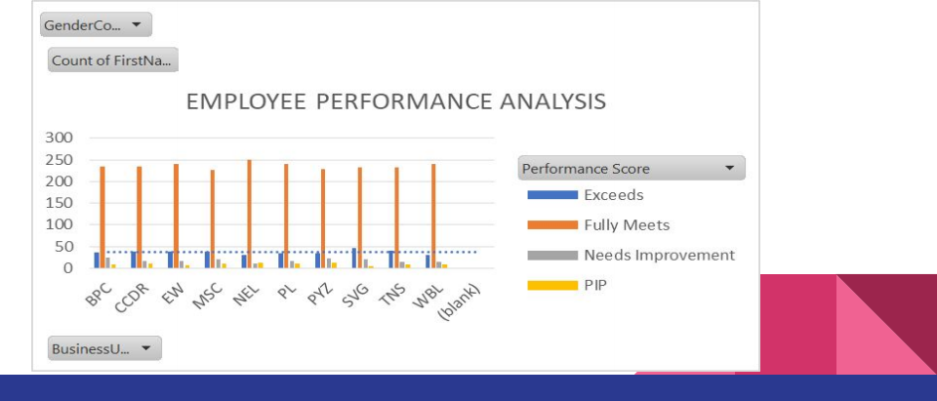
RESULTS

Slide 12
Conclusion
Our solution goes beyond mere metrics. It combines advanced analytics with qualitative feedback to provide a holistic view of employee performance, ensuring that every data point is
contextualized by human insights.
employee performance analysis is a crucial aspect of modern human resources management. By leveraging data-driven
insights, organizations can:
- Unlock employee potential
- Drive business growth
- Enhance leadership development

Slide 13


